Slide 1

Revolutionising B.Tech

Slide 2
Module 4: Input/output Organization
Course Name: Computer Architecture and organization[22CSE104]
Total Hours : 09

Slide 3
Computer Architecture
Computer architecture refers to the design of the internal workings of a computer system, including the CPU, memory, and other hardware components.
It involves the logical functions such as Instruction sets, Data types, Registers and Addressing modes.
Computer architecture is concerned with optimizing the performance of a computer system and ensuring that it can execute instructions quickly and efficiently.
Computer Architecture is also called Instruction Set Architecture (ISA).

Slide 4
Computer Architecture
Computer architecture refers to the design of the internal workings of a computer system, including the CPU, memory, and other hardware components.
It involves the logical functions such as Instruction sets, Data types, Registers and Addressing modes.
Computer architecture is concerned with optimizing the performance of a computer system and ensuring that it can execute instructions quickly and efficiently.
Computer Architecture is also called Instruction Set Architecture (ISA).

Slide 5
Lecture of Module 4
Input/Output Organization

Slide 6
Overview
▶ Peripheral Devices
▶ Accessing I/O Devices
▶ Input/Output Interface
▶ Types of Data Transfer
Asynchronous Parallel Data Transfer
Asynchronous Serial Data Transfer
▶ Asynchronous Communication Interface
▶ Interrupt
▶ Modes of Data Transfer
Programmed I/O
Interrupt driven I/O
Priority Interrupt
Direct Memory Access (DMA)
▶ I/O Channel and Processor
Introduction
▶ Flynn’s Classification
▶ Pipeline Architecture
▶ Pipeline Hazard
▶ RISC Architecture
▶ CISC Architecture

Slide 7
Peripheral Devices
▶ Input/Output devices that are connected to a system are called Peripheral devices.
▶ These devices are designed to read information into or out of the memory or CPU upon command from the CPU and are considered to be the part of computer system.
▶ For example: Keyboards, display units, printers etc. are common peripheral devices.
There are three types of peripherals:
Input peripherals: Allows user input from the outside world to the computer. Example:
Keyboard, Mouse etc.
Output peripherals: Allows information output from the computer to the outside world. Example:
Printer, Monitor etc.
Input-Output peripherals: Allows both input (from outside world to computer), as well as, output (from computer to the outside world). Example: External memory devices.

Slide 8
Accessing I/O Devices
▶ Generally more numbers of devices are connected to a computer.
▶ So, some means have to be provided by which a particular device can be selected to participate in a given I/O operation.
▶ This can be accomplished through the use of an I/O bus arrangement.
▶ I/O bus is the bus to which all I/O devices are connected used for
address, data and control signals.
▶ Each device is assigned an identifying code or address so that the CPU can select a particular device by placing its address in the address line.
▶ Only the device that recognizes its address responds to the CPU.
▶ This is called as I/O mapped I/O.

Slide 9
▶ An alternative arrangement for identifying I/O devices are by assigning them by an unique address within the memory address space of the computer.
▶ It become possible to access I/O device in the same way
as any other memory location accessing.
▶ This is known as Memory mapped I/O.

Slide 10
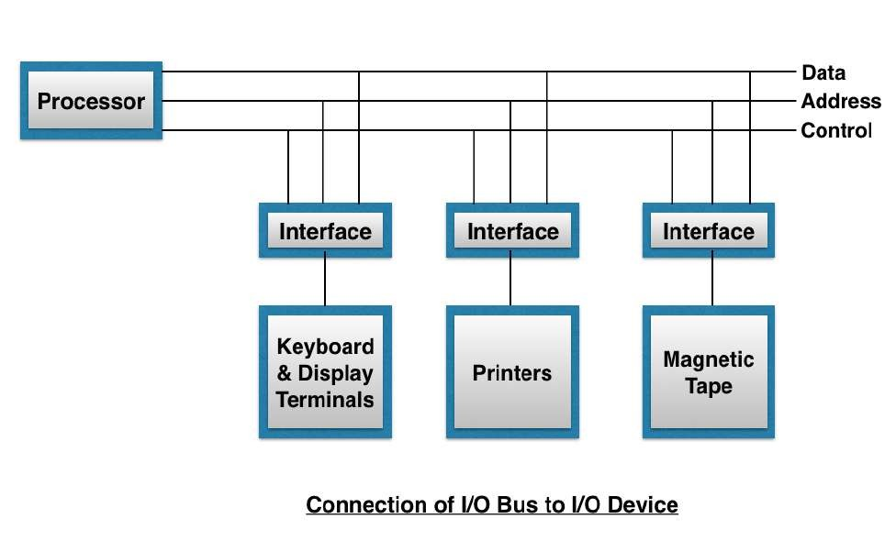
▶ Any machine instruction and addressing mode that can be used to deal with operands can also refer to an I/O device.
▶ The use of memory mapped I/O offers some flexibility in handling I/O operation.
▶ All the devices are
the I/O bus
connected to
through a hardware device or circuit is called as I/O Interface.

Slide 11
I/O Interface
▶ Input/Output Interface provides a method for transferring instruction between internal storage device and external I/O device.
▶ Peripherals connected to a computer need special
communication link for interfacing them with the CPU.
▶ The purpose of communication link is to resolve the differences that exists between the CPU and peripherals and among peripherals.

Slide 12
The major differences are as follows:
Peripheral devices are electromagnetic or electro-mechanical. The CPU is purely electronic device. The nature of operation of peripheral device is different from the operation of CPU. Therefore a conversion of signal values may be required.
The data transfer rate of peripherals are usually slower than CPU. So, synchronization mechanism may be needed.
The data code and formats in peripherals differ from the word format in the CPU
and memory. So, conversion mechanism may be needed.
The operating modes of peripherals are different from each other and each must be controlled so as not to disturb the operation of other peripherals connected to CPU.

Slide 13
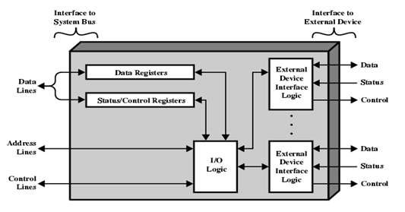
Interface Module
▶ To resolve these differences there is a need of special hardware component between CPU and peripheral devices to supervise and synchronize all input and output transfers.
▶ This component is called as Interface unit or
I/O module.
▶ The data register is used to hold data to be transferred.
▶ Status register is required to store the status, that is, status or condition of the device for operation.
▶ Control circuit is for receiving and sending control signals to or from control unit.

Slide 14
Types of Data Transfer
TypeTypess of Data Transfer
Parallel Data Transfer
Serial Data Transfer
Asynchronous Data Transfer
Synchronous Data Transfer
Asynchronous Data Transfer
Strobe Controlled
Handshaking
Source Initiated
Destination Initiated
Source Initiated

Slide 15
Parallel | Serial
1. Each bit has its own path & total message is transmitted at the same time. | 1. Each bit in the message is transmitted in sequence one at a time.
2. To transmit n-bit, n-separate wires are used. | 2. n-bit is transmitted through one wire.
3. Expensive due to multiple numbers of wires are used to transmit. | 3. Inexpensive as compare to parallel because single wire is used to transmit.
4. Speed is faster as data is transmitted through multiple wires. | 4. Speed is slow as data is transmitted through single wire.
5. Quite difficult to upgrade the system. | 5. Easy to upgrade the system.
6. Suitable for Short distance. | 6. Suitable for Long distance.
7. EX- CPU & Memory.(Bus) | 7. EX- CPU & I/O.

Slide 16
Synchronous Data Transfer
▶ Both sender and receiver share a common clock.
▶ For long distance transmission each unit is driven by separate clock of same
frequency.
▶ The transmitter transmits block of character along with synchronization information.
▶ The receiver decodes and find the synchronization information and keep its clock in step with each other.
▶ The transmitter sends data, and the receiver counts the number of bits in the received
data.
▶ Furthermore, there are no gaps between data, that is, continuous transmission till end.
▶ In this method, the timing signals must be accurate to transfer data efficiently.
▶ Moreover, this method is faster than asynchronous data transferring.

Slide 17
Asynchronous Parallel Data Transfer
▶ Asynchronous parallel data transfer between two independent units require control
signals for synchronization during the data transfer.
One way is by means of strobe pulse which is supplied by one of the units to other unit when transfer has to occur. This method is known as “Strobe Control”.
Another method commonly used is to accompany each data item being transferred with a control signal that indicates the presence of data in the bus. The unit receiving the data item responds with another signal to acknowledge receipt of the data. This method of data transfer between two independent units is said to be “Handshaking”.
▶ Here we consider the transmitting unit as Source and receiving unit as Destination.
▶ The sequence of control during an asynchronous transfer depends on whether the transfer is initiated by the source or by the destination.
▶ So, it can be further divided as source initiated and destination initiated.

Slide 18
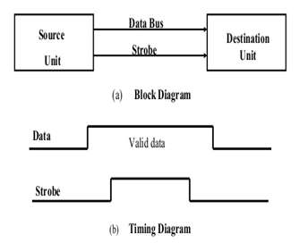
Source Initiated Strobe controlled
▶ The source unit first places the data on the data bus.
▶ After a brief delay to ensure that the data settle to
a steady value, the source activates a strobe pulse.
▶ The information on data bus and strobe control signal remains in the active state for a sufficient period of time to allow the destination unit to receive the data.
▶ The source removes the data from the data bus after
it disables its strobe pulse.
▶ The strobe signal disabled indicates that the data bus does not contain valid data.
▶ New valid data will be available only after the strobe
is enabled again.

Slide 19
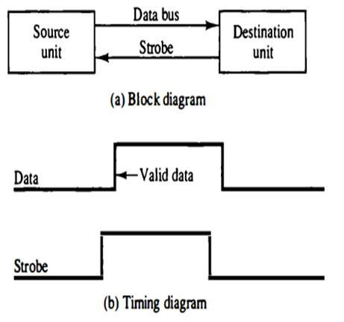
Destination Initiated Strobe controlled
▶ The destination unit initiates the data transfer.
▶ The destination unit first activates the strobe pulse, informing the source is ready to receive data or informing the source to provide the data.
▶ Then the source unit may place the data on the data bus.
▶ The data must be valid and remain in the bus
long enough for the destination unit to accept it.
▶ The destination unit then disables the strobe. And source removes the data from data bus after a time interval.

Slide 20
▶ In computer, in strobe initiated by source - the strobe may be a memory-write control signal from the CPU to a memory unit. The source, CPU, places the word on the data bus and informs the memory unit, which is the destination, that this is a write operation.
▶ In the strobe initiated by destination - the strobe may be a memory- read control from the CPU to a memory unit. Now the destination is the CPU, initiates the read operation to inform the memory, which is a source unit, to place selected word into the data bus.
▶ The transfer of data between the CPU and an interface unit is similar to the strobe transfer.

Slide 21
Disadvantage
▶ In source unit that initiates the transfer has no way of knowing whether the destination has actually received the data that was placed on the bus.
▶ In a destination unit that initiates the transfer has no way of knowing whether the source unit has actually placed data on the bus.
▶ The Handshaking method solves this.

Slide 22
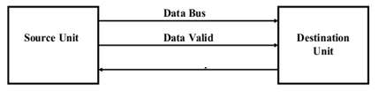
Handshaking
▶ The handshaking method is a two wire controlling method of data transfer.
▶ Handshaking method introduce a second control signal line that provides a reply to the unit that initiates the transfer.
▶ In it, one control line is in the same direction as the data flow in the bus from the
source to destination to indicate the presence of valid data on the data bus.
▶ The other control line is in the other direction from destination to the source.
▶ It is used by the destination unit to inform the source whether the data accepted or not.
Data accepted/Ready for data

Slide 23
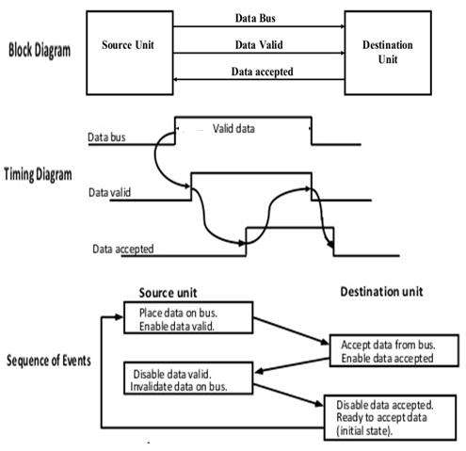
Source Initiated Handshaking
▶ Two handshaking lines are "data valid", which is generated by the source unit, and "data accepted", generated by the destination unit.
▶ The source initiates a transfer by placing data on the bus.
▶ Then enable the data valid signal.
▶
The data accepted signal is then activated by destination unit after it accepts the data from the bus.
▶ The source unit then disables its data valid signal which invalidates the data on the bus.
▶ After this, the destination unit disables its data
accepted signal and the system goes into initial state.
▶ The source unit does not send the next data item until the destination unit shows its readiness to accept new data by disabling the data accepted signal.

Slide 24
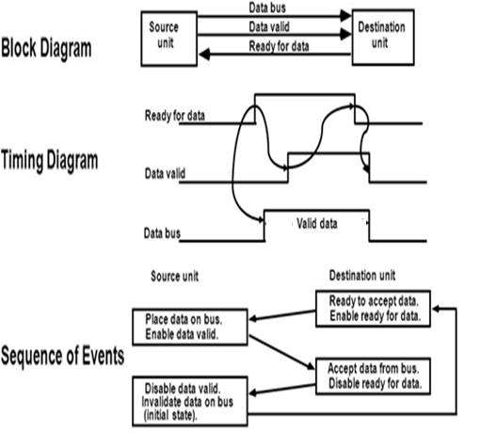
Destination Initiated Handshaking
▶ Two handshaking lines are "data valid", generated by the source unit, and "ready for data" generated by destination unit.
▶ Data transfer is initiated by destination, so source unit does not place data on data bus until it receives ready for data signal from destination unit.
▶ Enable ready for data.
▶ Source Places the data on data bus.
▶ Then enable the data valid signal.
▶ Destination accepts the data from the data bus.
▶ Then the destination disable the ready for data signal after data acceptance.
▶ Now the source disable the data valid signal which invalidate the data on data bus and the system goes into initial state.

Slide 25
▶ Data transfer between an interface and an I/O device is commonly controlled by a set of handshaking lines.
▶ The handshaking scheme provides a high degree of flexibility because the successful completion of a data transfer relies on active participation of both units.
▶ If a unit is faulty or the data transfer can not be performed during specified time the time out error is generated.

Slide 26
Asynchronous Serial Data Transfer
▶ The transmitter and receiver generates their clock frequencies independently, but they
are more or less identical.
▶ Generally adopted for low speed transmission.
▶ Data transmitted character by character.
▶ The time interval between two character is not fixed.
▶ The technique adopted for asynchronous serial data transmission is called FRAMING.
▶ In this technique each character carries the information of START Bit and STOP Bit.
▶ If there is no transmission in the line then the line is maintained in high voltage level –
MARK.
▶ START Bit always is voltage level of Zero (0) – SPACE.
▶ After Start bit the data bits are transmitted followed by PARITY Bit and STOP Bit.

Slide 27
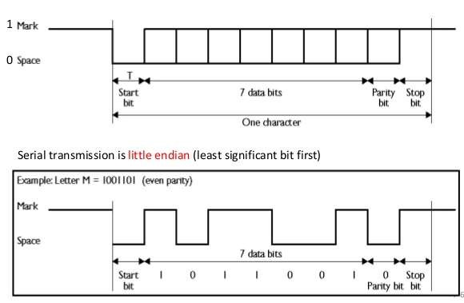
▶ The Parity bit may or may not present. If present always it is in either Low state (0) or High state (1) depending on Parity generator.
▶ The Stop bit may be one bit or more bits. Always they are in High state (1).
▶ So, during transmission the data bits are framed with Start bit and Stop bits, called Framing.

Slide 28
Synchronous Data Transfer | Asynchronous Data Transfer
1. Two units share a common clock. | 1. Two units are independent and each unit will have their own private clock.
2. Data transfer between sender and receiver are synchronized by the same clock pulse. | 2. Data transfer between sender and receiver is not synchronized by the same clock pulse.
3. Used between the devices that matches in speed. | 3. Used between the devices that does not match in speed.
4. The time interval of transmission is constant (due to common clock) | 4. The time interval of transmission is random (due to random common clock)
5. Bits are transmitted continuously to keep clock synchronized in both units. | 5. Bits are sent only when it is available and the line remains idle when there is information is transmitted.
6. Fast. | 6. Slow.
7. Costly. | 7. Economical.

Slide 29
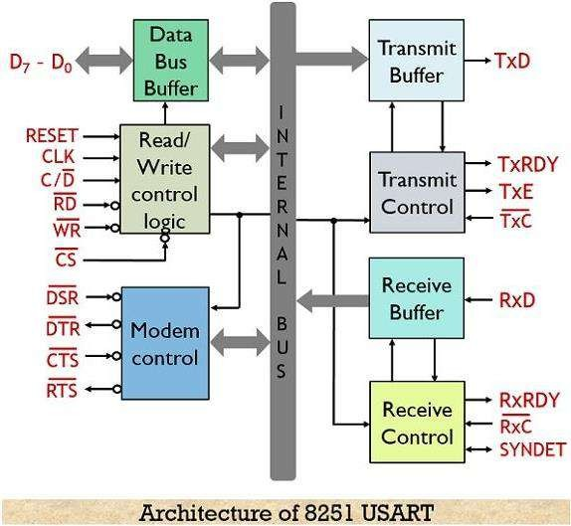
Communication Interface
▶ Serial transfer may be synchronous or asynchronous.
▶ The IC 8251A is a programmable chip designed for
synchronous communication.
▶ It is 25 pin DIP.
and asynchronous serial data
▶ It includes five blocks.
Data bus buffer
Read/Write control logic
Modem control
Transmitter
Receiver
▶ It is also Asynchronous
called as Universal Receiver
Synchronous
and Transmitter (USART).

Slide 30
Interrupt
▶ A computer must have some means to coordinate its activities with the external devices connected to it.
▶ When accepting characters from a keyboard, the computer needs to know when a new character has been typed.
▶ Similarly, during the output operation, it should send a character to a printer if the printer is ready to accept it.
▶ The current status of each I/O device connected to a computer is indicated by one or more bits of information.
▶ A program may run within the CPU to poll the device by testing the status bits before using an I/O
instruction to transfer data.
▶ During this polling period the CPU does not perform any useful computation.
▶ So, an alternative arrangement is required that when the I/O device will ready, it will alert the CPU.
▶ This can be possible by sending a signal called Interrupt.

Slide 31
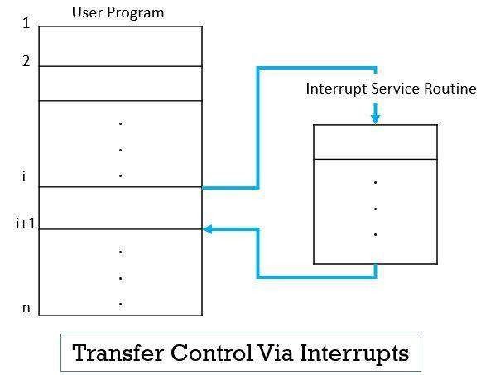
▶ An interrupt is a signal emitted by hardware or software that requests the processor to suspend its current execution and service the occurred interrupt.
▶ To service processor corresponding routine (ISR).
the interrupt the
the
executes
interrupt service
▶ After the execution of the interrupt service routine, the processor resumes the execution of the suspended program.

Slide 32
Types of Interrupt
▶ There are two types of interrupt.
Hardware Interrupt
Software Interrupt
▶ Hardware Interrupt: If the signal for the processor is from external or
internal device or hardware is called hardware interrupt.
▶ Example: From keyboard we will press the key to do some action, this pressing of key in keyboard will generate a signal which is given to the processor to do action, such interrupt is hardware interrupt.
▶ Hardware interrupt may be generated from external device/hardware or
internal device/hardware.
▶ So, it may be External interrupt or Internal interrupt.

Slide 33
▶ External Interrupt: It comes from I/O devices, timing device, power failure or
from any other external hardware.
▶ Example:
I/O device request for transfer of data. I/O device finished transfer of data.
Elapse of time of an event – Time out
Power failure etc.
▶ Internal Interrupt: Arises illegal or erroneous use of an instruction or data and any overflow/underflow condition.
▶ Example:
Register overflow/underflow. Stack/Queue overflow/underflow. Attempt to divide by zero.
Invalid operation code etc.

Slide 34
▶ The hardware interrupts may be maskable or non-maskable.
▶ Maskable Interrupt: The hardware interrupt that can be ignored or delayed for some time if the processor is executing a program with higher priority are termed as maskable interrupts.
▶ This type of interrupt is entertained by the CPU just after completion of current execution.
▶ Non-Maskable Interrupt: The hardware interrupts that can neither be ignored nor delayed and must immediately be serviced by the processor are termed as non-maskable interrupts.
▶ When a non-maskable interrupt arises, the CPU suddenly stops the
current execution and jumps to entertain the interrupt.

Slide 35
▶ Software Interrupts: A software interrupt is initiated by executing an instruction.
▶ This type of interrupt can be used by the programmer to initiate an interrupt procedure at any desired point in the program.
▶ Software interrupt is a special CALL instruction that behaves like an interrupt rather than a
subroutine call.
▶ When an interrupt is initiated the Interrupt Service Routine (ISR) is executed.
▶ The way the processor chooses the branch address of the service routine, the interrupt may
be Non vectored interrupt or Vectored interrupt.
▶ Non vectored: In this case the branch address is assigned to a fixed location in the memory where corresponding ISR is stored.
▶ Vectored: The source of the interrupt that supplies the branch information to the computer.
▶ This information is called the interrupt vector.

Slide 36
Modes of Data Transfer
▶ The data transfer between CPU and I/O devices may be handled in a variety of modes.
▶ Some modes use the CPU as an intermediate path, others may transfer data directly to and from the memory unit.
▶ Data transfer to and from peripherals may be handled in one of
the three possible modes.
Programmed I/O
Interrupt initiated I/O
Direct Memory Access (DMA)

Slide 37
Programmed I/O
▶ Programmed I/O operations are results of I/O operations written in computer program.
▶ Each data item transfer is initiated by an instruction in the program.
▶ Example: In this case, the I/O device does not have direct access to the memory unit. A transfer from I/O device to memory requires the execution of several instructions by the CPU, including an input instruction to transfer the data from device to the CPU and store instruction to transfer the data from CPU to memory.
▶ This is a time consuming process since it needlessly keeps the CPU busy.
▶ This situation can be avoided by using an interrupt facility.
ADD STORE X

Slide 38
Interrupt Initiated I/O
▶ In programmed I/O, the CPU remain busy unnecessarily.
▶ This situation can very well be avoided by using an interrupt driven method for data transfer.
▶ When the interface determines that the device is ready for data transfer, it generates an interrupt request signal to the CPU.
▶ In the meantime the CPU can proceed for any other program execution.
▶ Upon detection of an external interrupt signal the CPU momentarily stops the execution of current task, the control branches to a service routine to process the required I/O transfer, and then return to the task it was originally performing.
▶ But what if multiple devices generate interrupts simultaneously.

Slide 39
Priority Interrupt
▶ In that case, there must have a way to decide which interrupt is to be serviced first.
▶ In other words, the priority must be assigned to all the devices for systemic interrupt servicing.
▶ The concept of defining the priority among devices so as to know which one is to be serviced first in case of simultaneous requests is called priority interrupt system.
▶ Generally devices with high speed of data transfer, such as, magnetic disks are assigned high priority than slow devices, such as, Keyboard.
▶ When multiple devices interrupt the system at the same time, the service given to
the device with highest priority.
▶ This could be done with either software or hardware methods.

Slide 40
Software Priority Method
▶ In this method a Polling procedure is used to identify the highest priority device by software
means.
▶ There is one common branch address for all interrupt to execute the ISR.
▶ The program that takes care of interrupts begins the execution of the ISR and Polls the interrupt sources in sequence.
▶ The order in which they are tested determines the priority of the interrupt and its
corresponding device.
▶ If the highest priority device interrupt signal is on, then the service is given to that device.
▶ Otherwise, the next lower priority source is tested and so on.
▶ The major disadvantage of this method is that it is quite slow.
▶ To overcome this, we can use hardware priority interrupt.

Slide 41
Hardware Priority Method
▶ A hardware priority interrupt unit functions as an overall manager in an interrupt system environment.
▶ To speed up the operation, each interrupt source has its own interrupt vector to access its own ISR directly.
▶ So, no polling is required as all the decisions are established by the hardware priority interrupt unit.
▶ The hardware priority function can be established by either a serial
or a parallel connection of interrupt lines.
▶ The serial connection of hardware priority interrupt method is known as Daisy-Chaining Method.

Slide 42
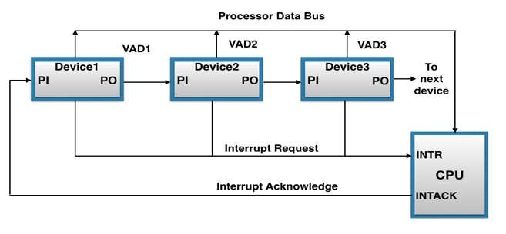
Daisy-Chaining Priority interrupt Method
PI | PO | Operation
0 | 0 | Acknowledge has been blocked
1 | 0 | Particular VAD selected (Pending interrupt)
1 | 1 | Transmit Acknowledge to next device

Slide 43
Direct Memory Access (DMA)
▶ The programmed I/O (CPU has to check for I/O device) and Interrupt-driven I/O (CPU doesn’t has to check for I/O device, I/O device generate the interrupt signal) require the active intervention of the processor to transfer data between memory and the I/O module, and data transfer must traverse through the processor.
▶ DMA is a process of communication for data transfer between memory and input/output device, controlled by an external circuit called DMA controller, without involvement of CPU.
▶ DMA is a way to improve processor activity and I/O transfer rate by taking-over the job of transferring data from processor and letting the processor to do other tasks.
▶ The DMA controller takes over the buses to manage the transfer directly between the I/O
devices and the memory unit.
▶ DMA controller is a hardware unit that allows I/O devices to access memory directly without the participation of the processor.

Slide 44
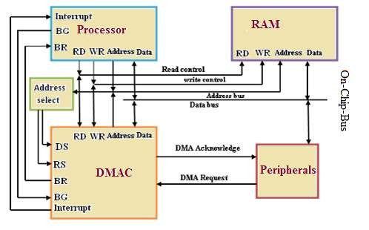
DMA Controller
▶ Whenever an I/O device wants to transfer the data to or from memory, it sends the
DMA request (DRQ) to the DMA
controller.
▶ DMA controller accepts this DRQ and asks the CPU to hold for a few clock cycles by sending it to the CPU Bus Request (BR) or Hold request (HLD) signal.
▶ Bus Request (BR) or Hold request (HLD): It is used by the DMA controller to request the CPU to relinquish the control of the buses.
IC 8257/8237

Slide 45
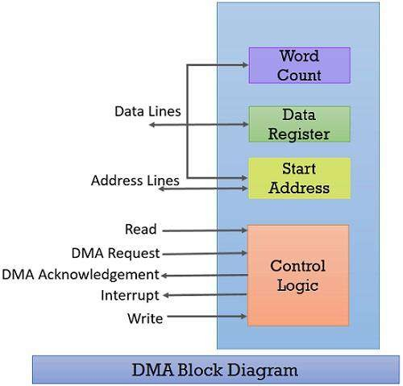
DMA block diagram
▶ The DMA controller has an address register, a word/data count register, data register and a control logic unit.
▶ Whenever a processor is requested to read or write a block of data, it instructs the DMA controller by sending the following information.
▶ The first information is whether the data has to be read from memory or the data has to write to the memory.
▶ It passes this information via read or write control line that is between the processor and DMA controller Control logic unit.

Slide 46
DMA Data Transfer
1. Burst Mode:
Here, once the DMA controller gains the charge of the system bus, an entire block of data is transferred in one contiguous sequence.
Then it releases the system bus to the CPU only after completion
of data transfer.
Till then the CPU has to wait for the system buses. CPU remains inactive relatively long period of time.
It can perform any work without the requirement of system bus.
Basically used to transfer large volume of data.
It is also called as Block transfer mode.

Slide 47
2. Cycle Stealing Mode:
In this mode, the data transfer is byte by byte or word by word.
The DMA controller forces the CPU to stop its operation and relinquish the control over the bus for a short period to DMA controller.
After the transfer of every byte, the DMA controller releases the bus and then
again requests for the bus.
This will continue to complete the data transfer of entire block.
In this way, the DMA controller steals the clock cycle for transferring every byte.
Basically used to transfer very small volume of data.
More time required to transfer total block of data.
But, CPU utilization is more than the Burst mode.

Slide 48
3. Transparent Mode
DMA controller takes charge of system bus for data transfer only when CPU performing operations without using system bus.
CPU executes the program and DMA controller takes charge of data transfer.
When the CPU requires the system bus the DMA controller releases the control over buses.
Complex hardware.
Advantages | - allows a peripheral device to read from/write to memory without going through the CPU
 | - allows for faster processing since the processor can be working on something else while the peripheral can be busy with memory
Disadvantages | - requires a DMA controller to carry out the operation, which increases the cost of the system
 | - cache coherence problems

Slide 49
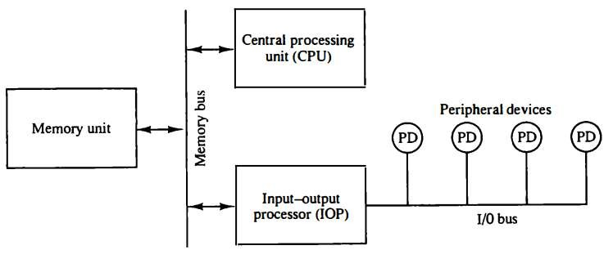
I/O Channel and Processor (IOP)
▶ Instead of having each interface communicate with the main processor, a computer may incorporate one or more external processor and assign them to communicate directly with all I/O devices.
▶ This secondary processor is called as I/O channel or I/O processor (IOP).
▶ The communication between the IOP and the devices is similar to the program control method of transfer.
▶ And the communication of IOP with the memory is similar to the direct memory access method.

Slide 50
▶ In a large computer, each processor is independent of other processors, and
any processor can initiate operations.
▶ The IOP operates independent from CPU and transfer data between peripherals and memory.
▶ The IOP is similar to a CPU except that it is designed to handle the I/O
communication.
▶ The CPU can act as master and the IOP act as slave processor.
▶ The CPU assigns the task of initiating operations but it is the IOP, who
executes.
▶ CPU instructions provide operations to start an I/O transfer.
▶ The IOP asks for CPU through interrupt.

Slide 51
Lecture of Module 5
Parallel Processing

Slide 52

Introduction
▶ Computation is execution of instructions that operates on data.
▶ Computer architecture can be classified based on the number of instructions that can be executed and how they operate on data.
Computer
Instructions
Data

Slide 53
An Overview of Parallel Processing
▶ What is parallel processing?
Parallel processing is a method to improve computer system performance by executing two or more instructions simultaneously.
▶ The goals of parallel processing.
One goal is to reduce the “wall-clock” time or the amount of real time that you need to wait for a problem to be solved.
Another goal is to solve bigger problems that might not fit in the limited memory of a single CPU.

Slide 54
Flynn’s Classification
▶ In general, digital computer can be classified in to four categories according to the multiplicity of instruction and data stream.
▶ The classification was proposed by Michael J. Flynn in 1966.
▶ It is the most commonly accepted taxonomy of computer organization.
▶ In this classification, computers are classified by whether it processes a single instruction at a time or multiple instructions simultaneously, and whether it operates on one or multiple data sets.
▶ Flynn proposed the following categories of computer systems.
Single Instruction Single Data (SISD)
Single Instruction Multiple Data (SIMD)
Multiple Instructions Single Data (MISD)
Multiple Instructions Multiple Data (MIMD)

Slide 55
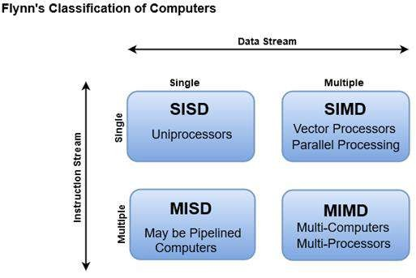




Computer Architectures
SISD
SIMD
MISD
MIMD

Slide 56


SISD
▶ SISD machines executes a single instruction on individual data values using a single processor.
▶ Traditional sequential architecture.
▶ Based on traditional Von Neumann uniprocessor architecture, instructions are executed sequentially or serially, one step after the next.
▶ Until most recently, most computers are of SISD type.
▶ Parallelism can be achieved by Pipelining.

Slide 57
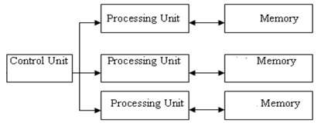

SIMD
▶ An SIMD machine executes a single instruction on multiple data values simultaneously
using many processors.
▶ Since there is only one instruction, each processor does not have to fetch and decode each instruction. Instead, a single control unit does the fetch and decoding for all processors.
▶ SIMD architectures include array processors (ILLIAC-IV).
▶ Shared memory system may contain multiple memory modules.

Slide 58



MISD
▶ Multiple operations on same data.
▶ The result from one processing unit is input to next processing unit.
▶ It is not clear till now whether such machine exists or not.
▶ Some people regards Pipeline architecture, Systolic array machine as MISD.

Slide 59
MIMD
▶ Multiple independent CPUs are there.
▶ It may execute multiple instructions simultaneously, contrary to SIMD machines.
▶ Multiple instruction streams operating on multiple data streams.
▶ Each processor must include its own control unit that will assign to the processor
parts of a task or a separate task.
▶ It may look like multiple SISD (MSISD).
▶ MIMD machines are usually referred to as Multiprocessor or Multicomputer.
▶ It may have shared memory architecture or distributed memory architecture.
▶ It may be tightly coupled or loosely coupled.
▶ Example: CRAY X-MP, IBM SP/2, CRAY T3E.

Slide 60





Interconnection Network
Shared Memory
Multiprocessor Architecture Shared Memory Architecture Tightly Coupled
Multicomputer Architecture Distributed Memory Architecture Loosely Coupled

Slide 61
Interconnection Topology
A system may also be classified by its topology.
A topology is the pattern of connections between processors.
The cost-performance tradeoff determines which topologies
to use for a multiprocessor system.

Slide 62
Whether parallelism can be achieved in uni-processor system?
Yes
Various techniques are there- Pipelining is one of them

Slide 63

Pipeline
What is Pipeline?
▶ To complete operation of an instruction some sub-operations are to be performed.
▶ Generally sub-operations are-
Instruction fetch
Instruction decode
Operand fetch
Execution etc.
OF
IF
ID
EX

Slide 64
▶ Whether the performance of the system enhanced if each sub-operation is performed in a dedicated segment?
That gives the concept of Pipeline
▶ Pipelining is used by all modern microprocessors to enhance the performance by overlapped execution of instructions.
▶ Analogous to fluid flow in pipelines and assembly line in factories.
▶ It is a technique of decomposing a sequential process into sub-operations with
each sub-operation being in a dedicated segment.
▶ Each segment performs partial processing and is transferred to the next segment in the pipeline.
▶ The final result is obtained after the instructions have passed through all
segments.

Slide 65
▶ If the stages of a pipeline are not balanced and one stage is slower than another, the entire throughput of the pipeline is affected.
▶ The overlapping of computation is made possible by associating register with
each segment in the pipeline.
▶ Registers provide isolation between each segment so that each can operate on distinct data simultaneously.
▶ In a non pipelined computer, these steps must be completed before the next
instruction can be issued.
▶ Pipelining doesn’t help latency of single instruction, it helps throughput of entire workload.
▶ Time taken by each stage is t_{p} and that is to be decided first.

Slide 66



General Structure of Pipeline
Clock
S ₁
R1
S₂
R2
S ₃
R3
S ₄
Input
i
IF | ID | OF | EX
Non-Pipeline
i+1
IF | ID | OF | EX
i+2
IF | ID | OF | EX
i
IF
ID
OF
EX
Pipeline
i+1
IF
ID
OF
EX
i+2
IF
ID
OF
EX

Slide 67






























Space-Time Diagram
1 2 3 4 5 6 7 8 9
I3
Clock cycles
IF
ID OF EX
I1
I2
Segment
I1
I2
I1
I2
I1
I2
1 2 3 4 5 6 7 8 9
Clock cycles
Segment
IF I1 I2 I3
ID OF
EX
I4
I5 I6
I1
I2 I3
I4
I5
I6
I1 I2 I3 I4 I5 I6
I1 I2 I3 I4 I5 I6

Slide 68
Non-pipeline vs. Pipeline
n: Number of tasks to be performed Conventional Machine (Non-Pipelined)
t_{n}: Clock cycle
t₁: Time required to complete the n instructions
t₁ = n * t_{n}
Pipelined Machine (k stages)
t_{p}: Clock cycle (time to complete each sub operation) t_{k}: Time required to complete the n instructions
t_{k} = (k + n - 1) * t_{p}
Speedup (S_{k})
S_{k} = n*t_{n} / (k + n - 1)*t_{p}
t_{n}
S_{k} = k, this is the maximum theoretical Speed up that a Pipeline can achieve.
lim S =
= k, if t = k * t
n → ∞
k
t_{p}
n
p

Slide 69
Efficiency (E_{k})
S_{k}
n*t_{n}
n
E_{k} =
=
=
k
k (k + n - 1)*t_{p}
k + (n-1)
If n >> k then
E_{k} = 1
Throughput (H_{k})
The number of instructions completed per unit time
_{H =} n E_{k}
1
k
[ k + (n-1)] t_{p}
=
If E = 1 then
H =
k
k
t
t_{p}
p
Pipelined system is better than non-pipelined system

Slide 70
▶ Generally there are two areas of computer design where the pipeline mostly applicable.
Instruction pipeline
Arithmetic pipeline
▶ The pipeline what are discussed is Instruction pipeline.
i
IF | ID | OF | EX
i+1 | IF | ID | OF | EX
i+2 |  | IF | ID | OF | EX
▶ The Arithmetic pipeline divides an arithmetic operation into sub-operations for execution
in the pipeline segments.
▶ Pipelined arithmetic units are usually found in very high speed special purpose computers.
▶ Generally they are used to solve scientific, complex problems etc.
▶ An array multiplier is an example of pipelined multiplier.

Slide 71
Example of Arithmetic Pipeline
▶ Suppose we want the operation Ai × Bi + Ci for i = 1, 2, 3, …, n
Ai Bi Ci
R1
R2
Multiplier
R4
R3
Adder
R5
Design arithmetic pipeline for floating point
addition/subtraction and multiplication/division.

Slide 72
Comments about Pipeline
The good news
Multiple instructions are being processed at same time
Best case speedup is equal to number of stages of the pipeline
The bad news
Instructions interfere with each other and unable to proceed at their designated t_{p} - Hazard
Example: different instructions may need the same piece of hardware (e.g., memory) in
same clock cycle – Structural Hazard
Example: instruction may require a result produced by an earlier instruction that is not yet complete – Data Hazard
Example: branch and other instructions that changes the PC makes the fetch of the exact instruction to be delayed or some of the wrong instructions entered to pipeline – Control Hazard

Slide 73
CPU Architecture
▶ An important aspect of CPU architecture is the design of the instruction set for the processor.
▶ The instruction set chosen for a particular computer determines the way that
machine language programs are constructed.
▶ As digital hardware became cheaper with the advancement of integrated circuits, computer instructions tended to increase both in number and complexity.
▶ In one approach, a computer has large number of instructions and many of which are capable of performing complex tasks.
▶ A computer that follows this approach is referred to as a Complex Instruction Set Computer (CISC).

Slide 74
CISC
▶ incorporating a large number of powerful instructions.
▶ The number of instructions are more and of variable length.
▶ More number of addressing modes.
▶ The goal is to reduce the size of the compiled program and to improve the performance.
▶ Algorithms can be expressed in more concise form.
▶ Because of the limited size of the compiled program, the requirement for main memory is also small.

Slide 75
▶ The lesser the number of instructions in a compiled program, the lesser is the time spend by the CPU to fetch instructions.
▶ This decreases the execution time considerably.
▶ However, a highly efficient compiler is required to use the powerful instructions more frequently.
▶ Hence, the system software (compiler) becomes huge in order to generate a
small object code.
▶ High level statements are implemented in hardware using complex decoding circuits. Thus, more emphasis is given to the hardware.
▶ Example: Motorola 68000, DEC VAX, IBM 370, Intel Pentium etc.

Slide 76
Advantages
▶ Presence of more varieties of instructions, variable length instructions, and more addressing modes eases the task of the compiler writer.
▶ Improved execution efficiency, because complex sequence of operations
can be implemented in microcode.
▶ Provides support for even more complex and sophisticated high-level language.
▶ Programs are shorter and faster.
▶ Fewer instructions means fewer instruction bytes to be fetched.
▶ In a paging environment, smaller programs occupy fewer pages, reducing number of page faults.

Slide 77
Disadvantages
▶ The control unit design (mainly instruction decoding) becomes complex since the instruction set is large with heavily encoded instructions.
▶ There is a lot of hardware circuitry due to complexity of the CPU. This increases the hardware cost of the system as well as power consumption.
▶ Due to increased circuits, the propagation delays are more, and the CPU cycle time is large and hence, the effective clock speed is reduced.
▶ The heavy hardware prone to frequent failures.
▶ Troubleshooting and detecting a fault is a big task due to presence of a large number of circuits.
▶ These complex hardware circuits compete for space with the CPU registers leading to reduction in the
number of general-purpose registers.
▶ Reduction in the number of general-purpose registers leads to more memory-to-memory operations which increases the average clock cycles required to complete an instruction execution.
▶ Not suitable for pipeline implementation due to presence of variable length instructions as balancing
pipeline stages becomes difficult.

Slide 78
RISC
▶ The second approach follows a different type of architecture.
▶ It is observed that usually 80% of instructions are used less frequently only for 20% of the time.
▶ The 20% of instructions are used more frequently for 80% of the time.
▶ Keeping this point RISC architecture has been developed.
▶ Only simple instructions.
▶ Small instruction set.
▶ Instruction length remains same for all the instructions.
▶ Single clock cycle instruction execution.
▶ Large number of registers for storing the operands.
▶ Emphasis on register-to-register operation.

Slide 79
▶ The only references to memory are limited to load and store of an operand.
▶ Reduced addressing modes. This makes decoding instructions easy.
▶ Almost all instructions use register addressing mode except load and store.
▶ Additional addressing modes like implied or immediate addressing mode may be
included.
▶ Decoding circuits can be integrated as part of the CPU chip. This enables instruction decoding faster.
▶ Suitable for pipeline processing. Emphasis on optimizing the instruction pipeline.
▶ No operation that combine LOAD/STORE with arithmetic.
▶ No more than one memory-addressed operand per instruction.
▶ Hardwired rather than microprogrammed control unit.
▶ Example: Motorola 88000, Intel i860, Power PC

Slide 80
Advantages
▶ Presence of simple instructions makes it low cycles per instruction.
▶ Reduced instructions lead to less hardware circuits.
▶ More space available for general purpose registers.
▶ Instruction execution is faster.
▶ More operands can be stored in registers
▶ Less memory references will be generated making instruction execution faster.
▶ Simple instruction format simplify the control unit.
▶ Suitable for pipeline implementation and easier to balance the pipeline stages.

Slide 81
Disadvantages
▶ Simple instructions make code size larger.
▶ More instruction bytes to be fetched.
▶ More memory space required to store program.
▶ In a paging environment, larger programs occupy more pages, increasing number of page faults.

Slide 82
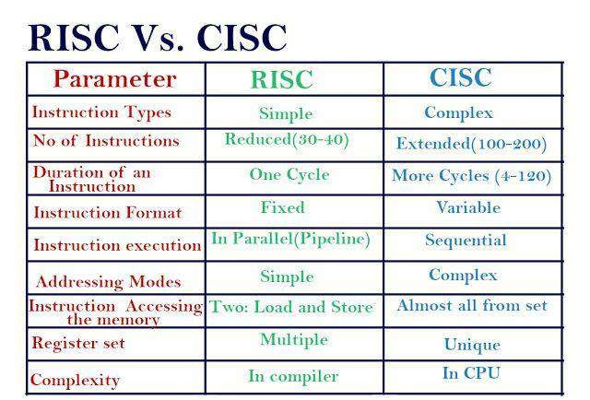

Slide 83
What is a Vector Processor?
Also called an Array Processor.
Runs multiple mathematical operations on multiple data elements simultaneously.
Common in supercomputers of the 1970’s 80’s and 90’s.
Today most CPU designs contains at least some vector processing instructions, typically referred to as SIMD.
Typically operate on a few vectors elements per clock cycle in a pipeline v. SIMD which will operate on all at once.

Slide 84
History
1962 University of Illinois Illiac IV - completed 1972 with 64 ALUs 100-150 MFlops (massively parallel computer)
(1973) TI’s Advance Scientific Computer (ASC) 20-80 MFlops
(1975) Cray-1 first to have vector registers instead of keeping data in memory (8 registers with 64 64-bit words in each)
Cray-1 had separate pipelines for different instruction types allowing vector chaining. 80-240 MFlops

Slide 85
How It Works
3
Typical Vector Processor (Cell Processor)

Slide 86
Advantages
Each result is independent of previous results - allowing deep pipelines and high clock rates.
A single vector instruction performs a great deal of work - meaning less fetches and ewer branches (and in turn fewer mispredictions).
Vector instructions access memory a block at a time which allows memory latency to be amortized over many elements.
Vector instructions access memory with known patterns, which allows multiple memory banks to simultaneously supply operands.
Less memory access = faster processing time.

Slide 87
Disadvantages
Not as fast with scalar instructions
Complexity of the multi-ported VRF
Difficulties implementing precise exceptions
High price of on-chip vector memory systems
Increased code complexity

Slide 88
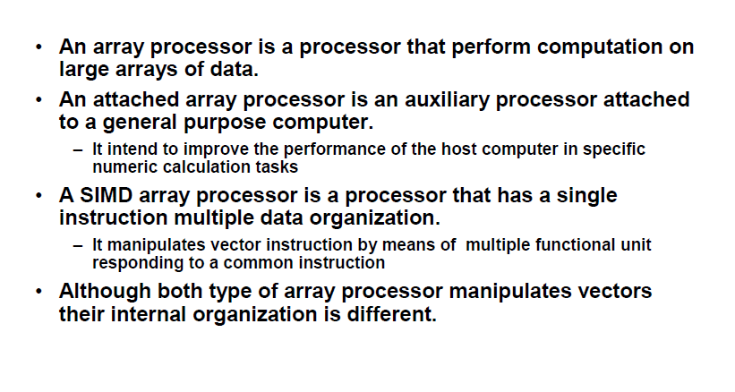
ARRAY PROCESSOR

Slide 89
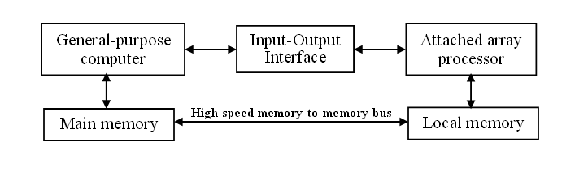
attached array processor with host computer

Slide 90
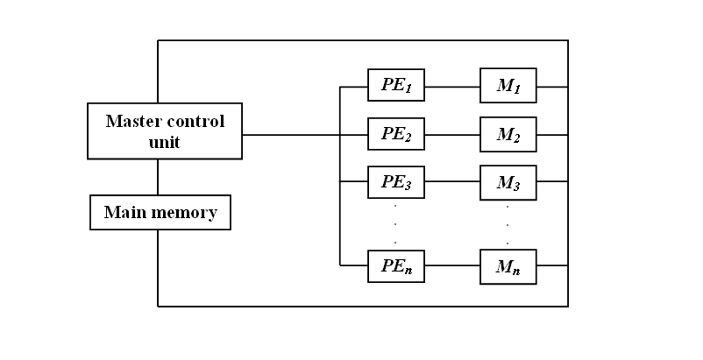
SIMD array processor Organization

Slide 91

Did You Know?
An encoder converts a set of binary inputs into a unique binary code.
Registers are fast Computer Memory

Slide 92

Summary
Outcomes:
Discuss the theory functionality and basic architecture of CPU
Discuss the Design Issues on the basis of speed, Technology, cost and performance.
Illustrate the different Logic Gates and Minimization of Logic gates.

Slide 93
Thank you

